Slide 1
KIVA Introduction NETLOGO
Muhammad Ryanda Nugraha M.
14 December 2020
Industrial Management Department
Center for Internet of Things Innovation
National Taiwan University of Science and Technology

Slide 2
Check Points

Slide 3
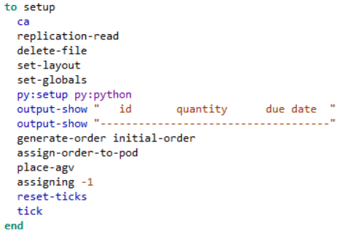


Setup
CODE
Setting up the Simulation
PROCESS FLOW
Go
Replication-read
Delete-file
CODE EXPLAINATION
Py:setup
Set globals
Set-layout
Replication-read Call function for read replication
Delete-file call function for delete file
Set-layout call function for setting layout
Output-show Function for printing
Generate-order initial-order : Function to generate order using initial-order
Assign-order-to-pod: function to assign order for the pod
place-agv: Place agv on layout
Assigning -1: Function to assign pod for AGV
Output-show
Generate-order
Assign-order-to-pod
Reset-ticks
assigning
Place-agv
ticks
End

Slide 4
SETUP
CODE
DICTIONARY
Ca : Function to choose “Celular Automaton” model
Py:setup py:python : setup python
Output-show : show output
Reset-ticks : reset tick’s counter
Tick : start tick’s counter
CODE EXPLAINATION
Replication-read Call function for read replication
Delete-file call function for delete file
Set-layout call function for setting layout
Output-show Function for printing
Generate-order initial-order : Function to generate order using initial-order
Assign-order-to-pod: function to assign order for the pod
place-agv: Place agv on layout
Assigning -1: Function to assign pod for AGV

Slide 5

Replication-read
CODE
Read replication
PROCESS FLOW
Go
carefully
CODE EXPLAINATION
Set replication
Let rep_ item
carefully[let rep_ item 0 csv:from-file "Replication.csv" set replication item 0 rep_][set replication 0]
Create temporary variable for saving “replication.csv” and then reset the value of the variable to 0

Slide 6
Replication-read
CODE
DICTIONARY
Carefully [ commands1 ] [ commands2]: Runs commands1. If a runtime error occurs inside commands1, NetLogo won't stop and alert the user that an error occurred. It will suppress the error and run commands2 instead.
Let : initialize variable value
Set : set variable value
Item 0 : item on index 0
Csv: from-file : get item from csv file
Replication.csv : An empty csv for temporary data storage
CODE EXPLAINATION
carefully[let rep_ item 0 csv:from-file "Replication.csv" set replication item 0 rep_][set replication 0]
Create temporary variable for saving “replication.csv” and then reset the value of the variable to 0

Slide 7
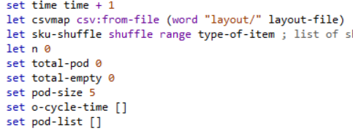
Set-layout
CODE
Setting up the Simulation’s layout
CODE EXPLAINATION
set time time + 1 : set and increment time variable
let csvmap csv:from-file (word "layout/" layout-file) : Open csv file from “layout” repository by name from layout-file variable
let sku-shuffle shuffle range type-of-item : iniatialize sky-shuffle by shuffling array with range of type of item
let n 0 : iniatialize n variable
set total-pod 0 : set total-pod variable value
set total-empty 0 : set total-empty variable value
set pod-size 5 : set pod-size variable value
set o-cycle-time [] : set o-cycle-time array
set pod-list [] : set pod-list array

Slide 8
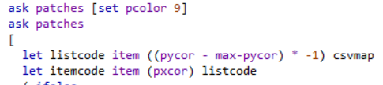
Set-layout (Cont)
CODE
Setting up the Simulation’s layout
CODE EXPLAINATION
Ask patches[set pcolor] : Set base color to 9
Ask patches - let listcode item ((pycor - max-pycor) * -1) csvmap : initialize listcode based on csvmap variable value - let itemcode item (pxcor) listcode : initialize itemcode varible based on listcode

Slide 9
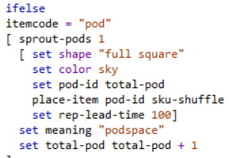
Set-layout
CODE
Setting up the Simulation’s layout
CODE EXPLAINATION
if else itemcode = [string] : Conditional for checking item code - itemcode = "pod"[ - sprout-pods 1 : create 1 pod
set shape "full square“ : set pod shape set color sky : set pod color
set pod-id total-pod : set pod-id based on current total pod
place-item pod-id sku-shuffle : call place item function with pod-id and sku-shuffle
set rep-lead-time 100 : set rep-lead-time variable value
set meaning "podspace“ : initialize meaning
set total-pod total-pod + 1: increment for variable value

Slide 10
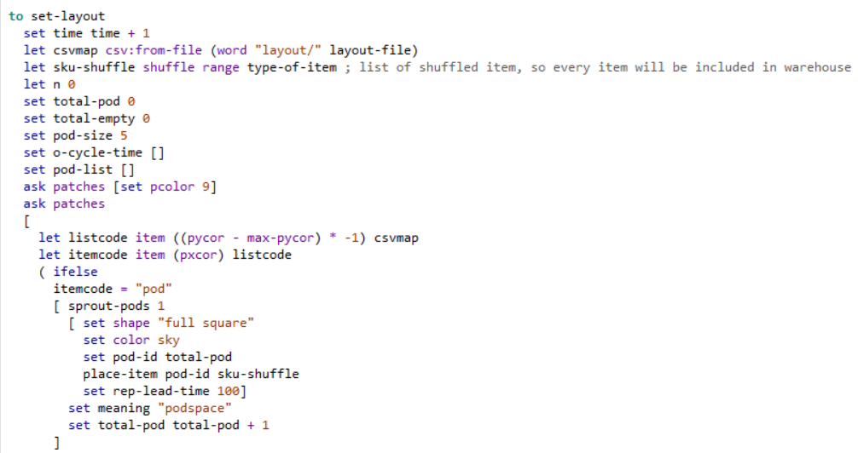
Set-layout
CODE
DICTIONARY
Ask patches … : Command every patches
Ifelse : Conditional if
Shuffle : shuffling list randomly
Range [range] : Generate list within\ range of [Range]
csv:from-file … : open csv file from given folder and its name
Word [value] : Declaring string with [value}
Sprout : Sprouting item (pod,empty,etc)
A
B
C
D

Slide 11
Set-layout (Cont)
CODE
Setting up the Simulation’s layout
CODE EXPLAINATION
let que-size item 0 sort [xcor] of turtles with [shape = "int7"] - item 0 sort [xcor] of picking-stations : initialize que-size with turtle that have shape “int7” after sorted based on xcor minus picking-stations
ask picking-stations [set entering-queue xcor + que-size]: call function picking-stations for set entering-que with xcor+que-size
ask turtles with [shape = "int7"][die]: Ask each turtle with shape “int7” to die

Slide 12
Set-layout (Cont)
CODE
Setting up the Simulation’s layout
DICTIONARY
sort : sorting list
sorting agentset
of : [reporter] of agent
[reporter] of agentset
with : agentset with [reporter]

Slide 13
Thank You
Ryanda
Industrial Management Department
Center for Internet of Things Innovation
National Taiwan University of Science and Technology

